Slide 1
STRINGS
Computer Engineering Department
Java Course
Assoc. Prof. Dr. Ahmet Sayar
Kocaeli University - Fall 2019

Slide 2
Useful Shortcuts for Netbeans IDE
sout+Tab: shortcut for System.out.println(“”);
fori+Tab
trycatch+Tab
iff+Tab
ifelse+Tab
forv+Tab
dowhile+Tab
psvm+Tab

Slide 3
Strings
Strings are essentially arrays of characters
The String class provides many functions for manipulating strings
Searching/matching operations
Replacing characters
Finding characters
Trimming whitespace
Etc.

Slide 4
Char vs. String
“h” is a String
‘h’ is a char
String is an Object; it contains methods
String s = "h";
s = s.toUpperCase(); // 'H'
int len = s.length(); // 1
char first = s.charAt(0); // 'H'
Char is primitive; you cant call methods on it
char c = 'h';
c = c.toUpperCase(); // ERROR: "cannot be dereferenced"

Slide 5
Comparing char values
You can compare char values with relational operators:
'a' < 'b' and 'X' == 'X' and 'Q' != 'q'
An example that prints the alphabet:
for (char c = 'a'; c <= 'z'; c++) {
System.out.print(c);
}
Çıktı: abcdefghijklmnopqrstuvwxyz

Slide 6
Declaring and Printing Strings
declaring
String greeting;
greeting = “Hello!”;
or
String greeting = “Hello!”;
or
String greeting = new String(“Hello!”);
printing
System.out.println(greeting);

Slide 7
Concatenation of Strings
Two strings are concatenated using the + operator.
String greeting = “Hello”;
String sentence;
sentence = greeting + “ officer”;
System.out.println(sentence);
???
Any number of strings can be concatenated using the + operator.
String solution;
solution = “The temperature is “ + 72;
System.out.println(solution);
System.out.println(solution.length());
Notes:
21

Slide 8
Concetentaion or processing
double a = 2, b=3;
System.out.println("a = "+a+b);
Difference???
double a = 2, b=3;
System.out.println("a = "+(a+b));

Slide 9
Some more useful codes Conversion by method
int to String:
String five = 5; // ?
String five = Integer.toString(5); // ?
String five = Double.toString(5) //?
String five = “” + 5; // ?
String to int:
int foo = “18”; // ?
int foo = Integer.parseInt(“18”); // ?
double d = Double.parseDouble(“18”); // ?
Notes:
Error
5
5.0
5
5
Error
Works
Works
5.0 diye mi yazar double yapınca

Slide 10
Double-double vs. Integer-int
Integer is class type – object type
int is primitive version of Integer
Double is class type – object type
double primitive version of Double

Slide 11

Strings are Arrays
A position is referred to an index.
The ‘f’ in “Java is fun.” is at index 8.
positions start with 0, not 1.
The ‘J’ in “Java is fun.” is in position 0
String str = "testString";
char[] charArray = str.toCharArray();

Slide 12
Strings
No methods allow you to change the value of a String object.
But you can change the value of a String variable.
value of pause
String pause = “ Hmm “; Hmm
pause = pause.trim() Hmm
pause = pause + “mmm!”; Hmmmmm!
pause = “Ahhh”; Ahhh

Slide 13
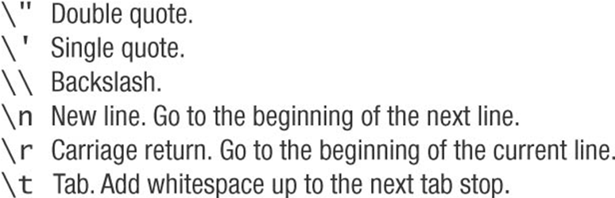
Escape Characters
Each escape sequence is a single character even though it is written with two symbols.

Slide 14
Examples
System.out.println(“abc\\def”);
abc\def
System.out.println(“new\nline”);
new
line
char singleQuote = ‘\’’;
System.out.println(singleQuote);
‘
String word1=“A”, word2=“B”, word3=“C”;
System.out.println("\""+word1 +"\"" +”\n” + word2+ "\t" + word3);
//How about using single quotation mark ‘\n’ ?
Notes:
"A"
B C
System.out.println("\'"+word1 +"\'" +'\n' + word2+ '\t' + word3);
Değişen bişe olmaz.
'A'
B C

Slide 15
String Concatenation (+)
String text = "hello" + " world";
text = text + " number " + 5;
Commenting:
// text = "hello world number 5“;
/* text = "hello world number 5“ */

Slide 16
Using ==, cont.
To test the equality of objects of class String, use method equals.
s1.equals(s2)
or
s2.equals(s1)
Or
s1 == s2
To test for equality ignoring case, use method equalsIgnoreCase.
(“Hello”.equalsIgnoreCase(“hello”))

Slide 17
Screen Output
System.out.print(“aaa”)
System.out.println(“bbb”)
The concatenation operator (+) is useful when everything does not fit on one line.
System.out.println(“When everything “ +
“does not fit on one line, use the” +
“ concatenation operator (\’+\’)”);
Alternatively, use print()
System.out.print(“When everything “);
System.out.print(“does not fit on “);
System.out.print(“one line, use the “);
System.out.print(“\”print\” ”);
System.out.println(“statement”);
ending with a println().

Slide 18
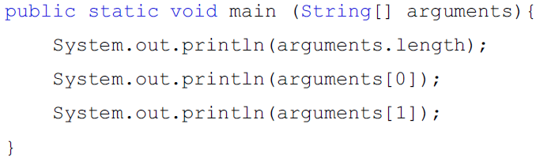
String as an Argument to Main

Slide 19
Arguments for the Method main, cont.
Alternatively, an array of String values can be provided in the command line.
example
java TestProgram Mary Lou
args[0] is set to “Mary”
args[1] is set to “Lou”
System.out.println(“Hello “ + args[0] +
“ “ + args[1]);
prints Hello Mary Lou.

Slide 20
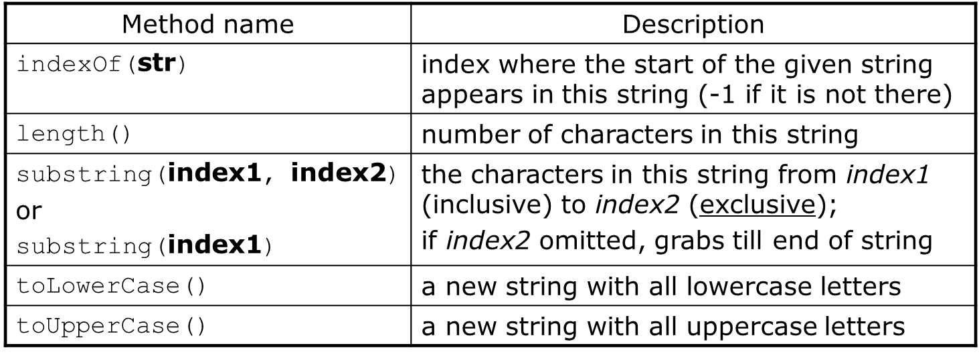
class String
These methods are called using the dot notation:
String gangsta = "Dr. Dre";
System.out.println(gangsta.length()); // 7
Notes:
String test = "Ali bize geldi";
System.out.println("----*** "+ test.indexOf("biz"));
4
String test = "Ali bize geldi";
System.out.println("----*** "+ test.substring(0,3));
Ali
3 değil 4 olsa son şndex ne olur – yine Ali olur
String test = "Ali bize geldi";
System.out.println("----*** "+ test.substring(4));
bize geldi

Slide 21
Class String - Cntd
Method | Description
equals(str) | whether two strings contain the same characters
equalsIgnoreCase(str) | whether two strings contain the same characters, ignoring upper vs. lower case
startsWith(str) | whether one contains other's characters at start
endsWith(str) | whether one contains other's characters at end
contains(str) | whether the given string is found within this one
String name = console.next();
if (name.startsWith("Dr.")) { System.out.println("Are you single?"); } else if (name.equalsIgnoreCase("LUMBERG")) { System.out.println("I need your TPS reports."); }
Notes:
equals(str)
boolean equalsIgnoreCase(str)
boolean startsWith(str)
boolean endsWith(str)
boolean contains(str)

Slide 22
Class String -Cntd
Method | Description
compareTo(String str) | Compare two strings character by character. Returns 0 if this string is the same as str
concat(String str) | Returns the string that is this string concatenated
charAt(int index) | Returns the character at the position specified by index
indexOf(char ch) | Returns the index of the first occurrence of the character specified by ch. If the character is not found returns -1
Replace(char c1, char c2) | Returns the string in which every occurrence of c1 is replaced with c2.
String major = "CSE";
for (int i = 0; i < major.length(); i++) {
char c = major.charAt(i);
System.out.println(c);
}
Notes:
int compareTo(String str)
String concat(String str)
char charAt(int index)
int indexOf(char ch)
String Replace(char c1, char c2)
C
S
E

Slide 23
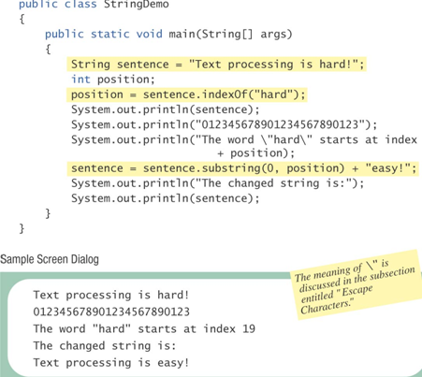

Slide 24
public class StringDemo_1 {
public static void main(String[] args)
{
String sentence = new String( "Text processing is hard!");
int position;
char a =sentence.charAt(1);
System.out.println(a);
sentence.concat("....");
System.out.println(sentence);
sentence=sentence.concat("....");
position = sentence.indexOf("hard");
System.out.println(sentence);
System.out.println("012345678901234567890123");
System.out.println("The word \"hard\" starts at index "
+ position);
sentence = sentence.substring(0, position) + "easy!";
System.out.println("The changed string is:");
System.out.println(sentence);
}
}

